Slide 1
Technical Design

Slide 2
CONTENTS
1
System Architechture
4
Class Diagram
2
Aplication Achitechture
5
Activity Diagram
3
Java packages Organization
6
Sequence Diagram

Slide 3
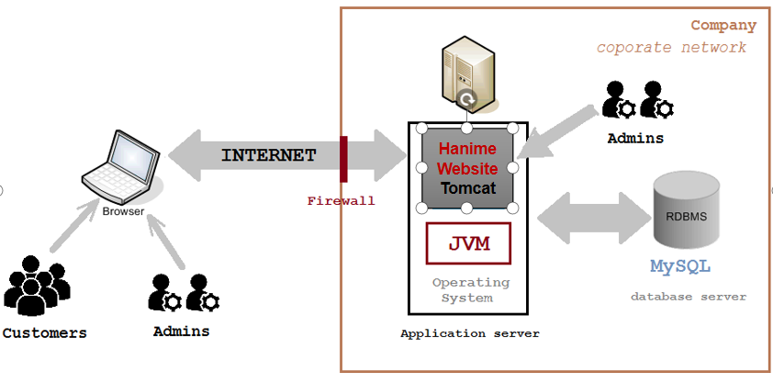
Client - Server Architecture

Slide 4
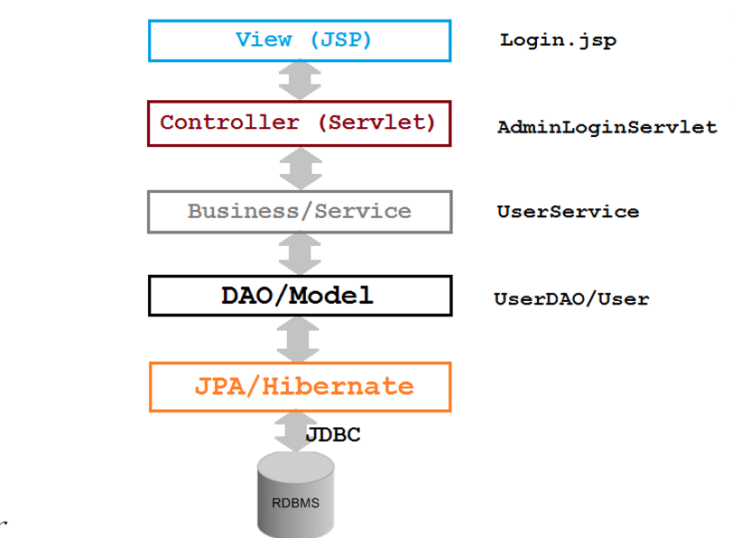
Aplication Architecture

Slide 5
Click here to add to the title

Slide 6
Click here to add to the title

Slide 7
Click here to add to the title

Slide 8
Click here to add to the title

Slide 9
Thank you
Click here to add a subtitle

